Slide 1
Deploying Windows 7
Lesson 3

Slide 2
Objectives
Understand enterprise deployments
Capture an image file
Modify an image file
Deploy an image file
Notes:
Outline the material you are going to cover in this lesson. Do not go into detail as each of these points will be expanded on in the lesson. You may also want to mention the Technology Skills that are being covered for the Certification exam also.

Slide 3
Understanding Enterprise Deployments
Careful planning is required and the following objectives must be considered:
Create standardized computing environments
Minimize user interaction at the workstation
Ensure continued functionality of all hardware and software resources
Minimize interruption of user productivity
Notes:
Emphasize why the planning process is so important and compare installing one computer to hundreds or thousands.

Slide 4
Steps to Deploy an Enterprise Workstation
Build a deployment share.
Perform a reference computer installation.
Capture an image of the reference computer.
Boot the target computers.
Apply the Windows 7 reference computer image.
Notes:
Expand on each of these general steps, and note that we will be talking about each step in more detail and look at the tools required to accomplish the steps.

Slide 5
Windows Deployment Tools
Windows 7 Automated Installation Kit
Microsoft Deployment Toolkit 2010
Windows Deployment Services
Notes:
Briefly introduce each tool.

Slide 6
Microsoft Deployment Toolkit (MDT) 2010
Superset of Windows 7 AIK for enterprise network deployments
Two types of deployments:
Lite-touch installation (LTI)
Zero-touch installation (ZTI)
Notes:
Review the differences in the 2 types of deployments and take note of the software that must be available on the network to support each one.

Slide 7
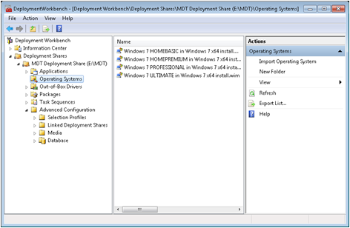
MDT 2010 Deployment Workbench Interface
Creates task sequences
Includes answer files and additional tasks
Can perform tasks before and after Windows 7 installation

Slide 8
Windows Deployment Services (WDS)
Included in Windows Server 2008
Used to deploy Windows imaging files over the network
Network must support:
Dynamic Host Configuration Protocol (DHCP)
Pre-boot Execution Environment (PXE)
Notes:
Explain the use of WDS and why it is useful in an enterprise deployment. Explain how it works and why the network must support DHCP and PXE. Also mention the discover image and using Windows PE.

Slide 9
Capturing image files

Slide 10
Image Files
Traditional files are sector-based.
Common extensions are .iso and .img.
Microsoft uses Windows Imaging files (.wim).
File-based images
Notes:
Review the differences between Sector-based and File-based images, and explain some of the advantages of File-based images.

Slide 11
Using Windows SIM
Creates answer files to streamline the process of creating multiple images
Provides responses to prompts that appear during Windows 7 installation
Partition and format disks
Install device drivers
Configure Windows 7 parameters
Notes:
Explain what answer files are used for.

Slide 12
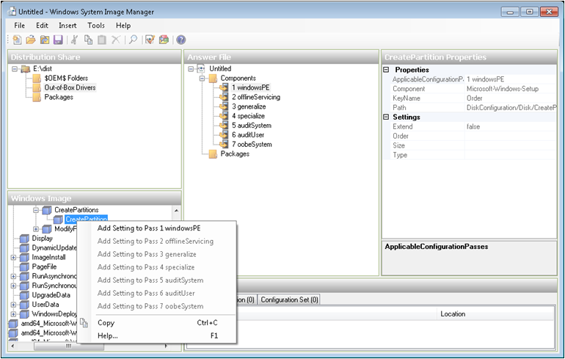
Answer File Settings
Notes:
Discuss configuration passes and that different elements get added to specific configuration passes.
You can also add device drivers and software packages to the distribution share that you want installed during the setup process.
Validate the answer file and correct any discrepancies.
Create the configuration set: includes all files added to the distribution folder along with the answer file.

Slide 13
Applying an Answer File
Copy the configuration set files to a removable medium (CD, DVD, or USB flash)
Boot from Windows 7 installation DVD
Insert removable media containing answer file
Windows setup scans for answer file
Can also start the installation from a Windows PE command prompt and specify the answer file

Slide 14
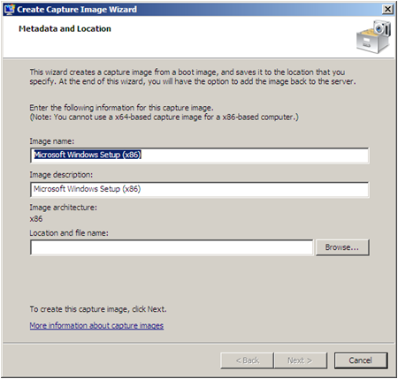
Capturing an Image Using WDS
Automates the capture process
Wizard-based
Create capture image and upload it to WDS server
Can be deployed immediately

Slide 15
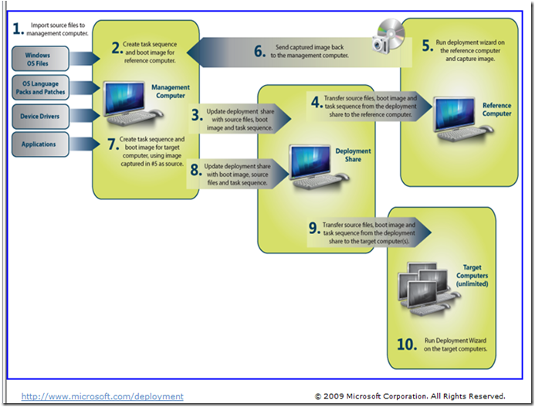
Capturing an Image Using MDT 2010
Notes:
Use the image above to describe the steps of creating an image using MDT 2010.

Slide 16
Introducing Deployment Image Servicing and Management (DISM.exe)
Used to modify image files while offline
Add device drivers
Add language packs
Add packaged updates
Enable or disable operating system features
Append a volume image to a workstation image
Combine multiple images in a single Windows Imaging file
Notes:
Describe what DISM is used for and what the basic steps are to modify an image.

Slide 17
Deploying Image Files

Slide 18
Understanding Image Types
Using thick images
Using thin images
Using hybrid images
Notes:
Discuss the different types of images and when each one might be used.

Slide 19
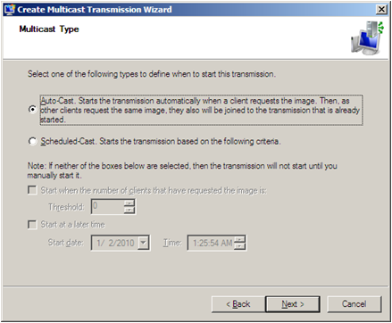
Deploying Images Using WDS
Can deploy images created with WDS, Windows 7 AIK, or MDT 2010
Requires a boot image
Multicasting with WDS
Notes:
Explain that WDS can be used as a self-contained solution for both creating and deploying image files, or it can be used to deploy images created with Windows 7 AIK or MDT 2010.
Define multicasting and explain how multicasting reduces network traffic. Point to the options on the dialog box to change the way the multicasting will start.

Slide 20
Deploying Images Using MDT 2010
Similar procedure to deploy as to create
Add images to deployment share
Create task sequences to apply images to target computers
Thick images – Simple task sequences
Thin or Hybrid – More scripting required
Notes:
Review points and expand where necessary. Look forward to next slide to review the entire MDT process, in particular the deployment part.

Slide 21

Deploying Images Using MDT 2010 (cont.)
Notes:
Review the deployment half of this chart.

Slide 22
Performing an LTI Deployment
Someone at the target computer has to:
Boot the computer
Run the Deployment Wizard
Select task sequence to install Windows 7
More interaction may be required depending on the task sequence
Less interaction at workstation requires more preparation for deployment and vice versa

Slide 23
Using System Center Configuration Manager 2007 (SCCM)
Required for Zero-touch installation deployment (ZTI)
Complex network management product
Can be used to capture and deploy image files in the same basic sequence as LTI
Uses SCCM tools instead of Deployment Workbench

